Slide 1


Group 3
Julien Bernardo Michael Gonzaga Pelin Mamaoglu Po Shan Sandra Kan Siddhant Banerjee | 1003515671 1006630488 1002972483 1003103447 1002976942
Notes:
Hey good afternoon
We are group 3 and the company our project is for is Airbnb

Slide 2
Presentation Roadmap
Model Building
01
03
Company Background
Methodology
Recommendation
02
04
Notes:
We’ll first talk a little about the company as well as the business problem we are trying to solve
next we’ll talk about the methodology of our model
Then the actual details of the model building
And finally our recommendations fro airbnb

Slide 3

Company Overview
Profit structure
Intermediary
10% commission and 3% payment processing fee from each booking
An online marketplace for booking or offering room & house rentals and tourism experiences
Target Market
Business model
Short stays and tourists
The company does not own any of the real estate listings, nor does it host events
Notes:
Airbnb is, as most of you know, an online marketplace for booking or offering room & house rentals and tourism experiences. The company does not own any of the real estate listings, nor does it host events. It acts as an intermediary between renters or travelers and homeowners. The purpose of bookings is mostly short stays focused on tourism. Airbnb makes profits by receiving a 10% commission and 3% payment processing fee from each booking. The company is based in San Francisco, United States.

Slide 4
Business Objective
What factors, if any, are predictive of where an Airbnb’s users first stay will be? Can we accurately predict where a customer will go for their first AirBnB stay?
By answering this question we could employ targeted marketing activities directly on Airbnb’s website to entice newly registered users to book their first destination with Airbnb.
Notes:
Our Business objective is whether we can predict where an Airbnb user’s first stay will be and based on our findings, what the top destinations to recommend will be for each user.
This is important because, if we can predict where the customer will go for his/her first trip, it would effect how Airbnb structures its website and experience as well as how it spends its marketing budget. Airbnb could better target its first users and advertise to them appropriately to increase their likelihood of the user booking their first destination with Airbnb

Slide 5
Marketing Environment
AirBnb’s Context
Competitive Forces
Demographic and cultural trends
Accommodation is available in 34,000 cities and 190 countries on Airbnb, and guest arrivals grew 100 times from 2011 to 2016. Currently 2 million people stay in an AirBnB per night.
Rental search engine for short term accomodations is disrupting the hotel industry; In Europe, Airbnb is 8-17% cheaper than an average hotel’s daily rate.
58% of booking guests/hosts worldwide are millennials. 77% of guests choose AirBnB in order to ‘live like a local’.
Notes:
Just some context on the market environment
Airbnb is a large company with presence in almost 200 countries with over 2 million people staying at Airbnb properties every night
It competes with online and local options. It tends to be cheaper than hotels, making airbnb popular among younger crowds with 58% of guests worldwide being millennials.

Slide 6
Methodology
02

Slide 7
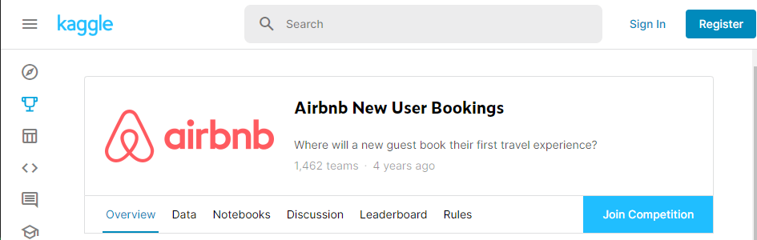
Our Database
Where we sourced the data
1
Notes:
So we sourced our data from Kaggle where Airbnb actually posted this data as a competition for teams to work on it

Slide 8
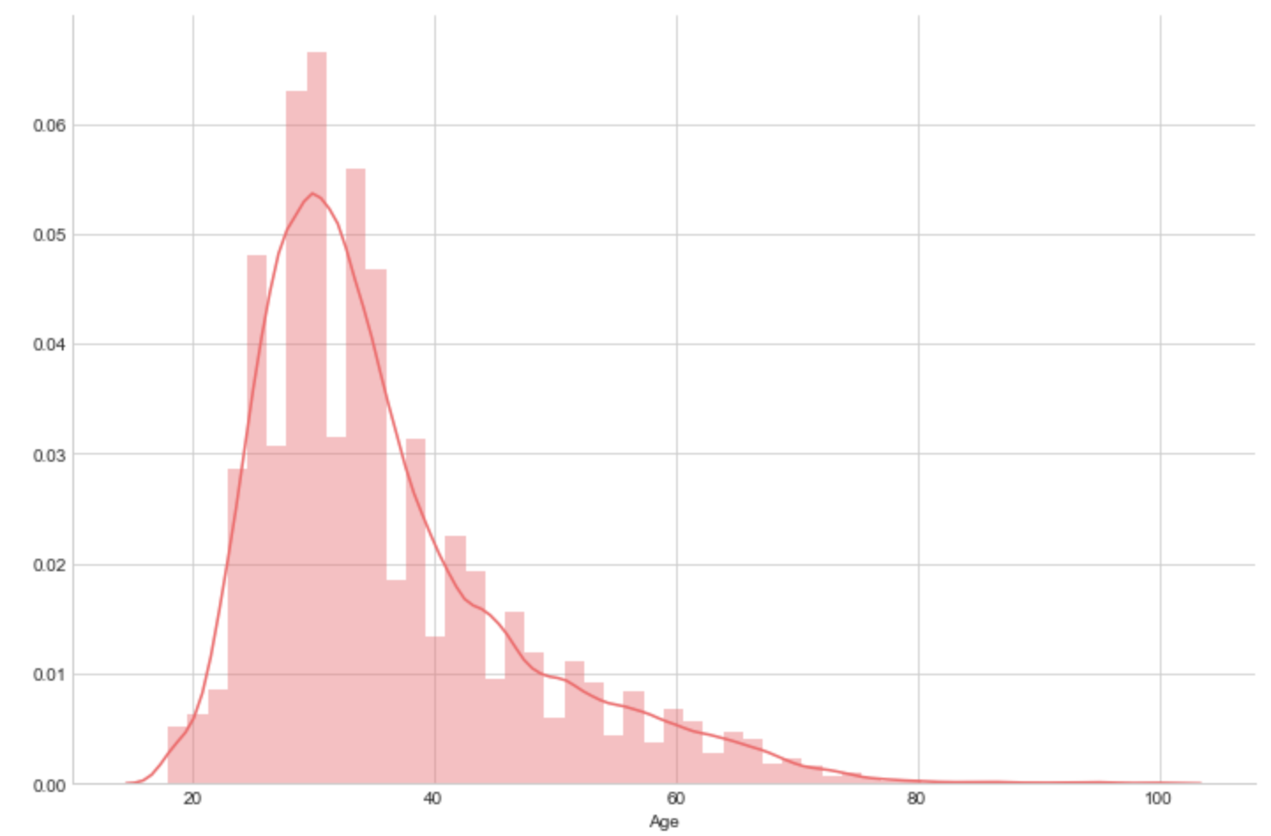
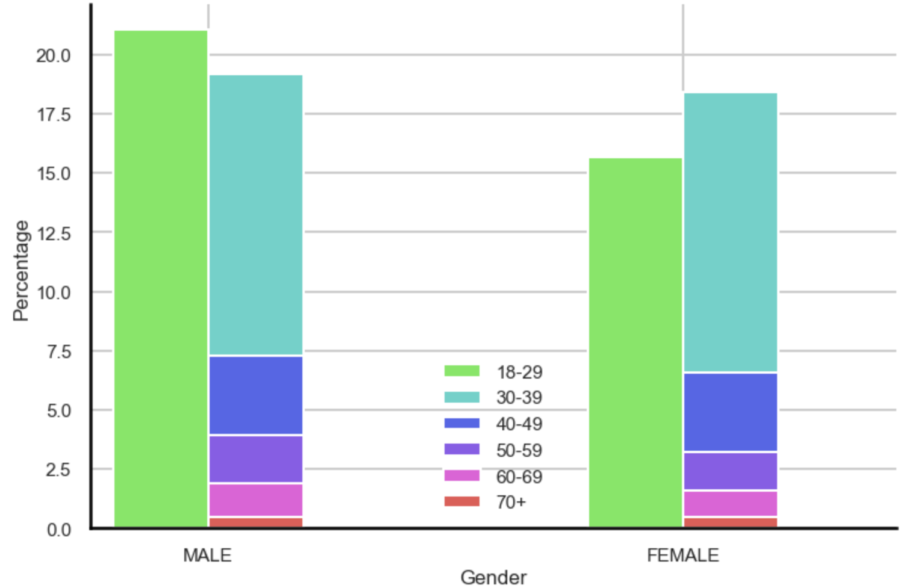
Who are the AirBnB users?
A descriptive analysis (demographics)
1
2
3
Gender Distribution
Female: 53.07%
Male: 46.64%
Other: 0.29%
Age Distribution
Mean = 36
Median = 33
Age & Gender
Males tend to be younger than females in Airbnb’s user base
Notes:
Just some descriptive statistics, we can see that in terms of gender, is more or less the same with females users being slightly more than male users. In terms of age, it is almost the same with mean and mean age being fairly young which isn’t surprising

Slide 9
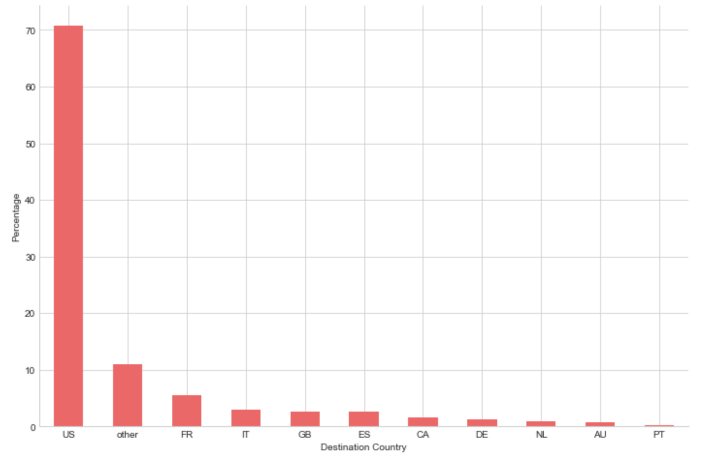
Where do they go?
A descriptive analysis (destination)
4
Top Destinations
U.S.A (70%)
France (5%)
Italy (3%)
Notes:
So where do these users go? Well its clear to see that the US is by far the most popular destination with other European countries trailing are behind. In this chart, other is a group of countries which weren’t large enough on their own to have their ow dummy variable.

Slide 10
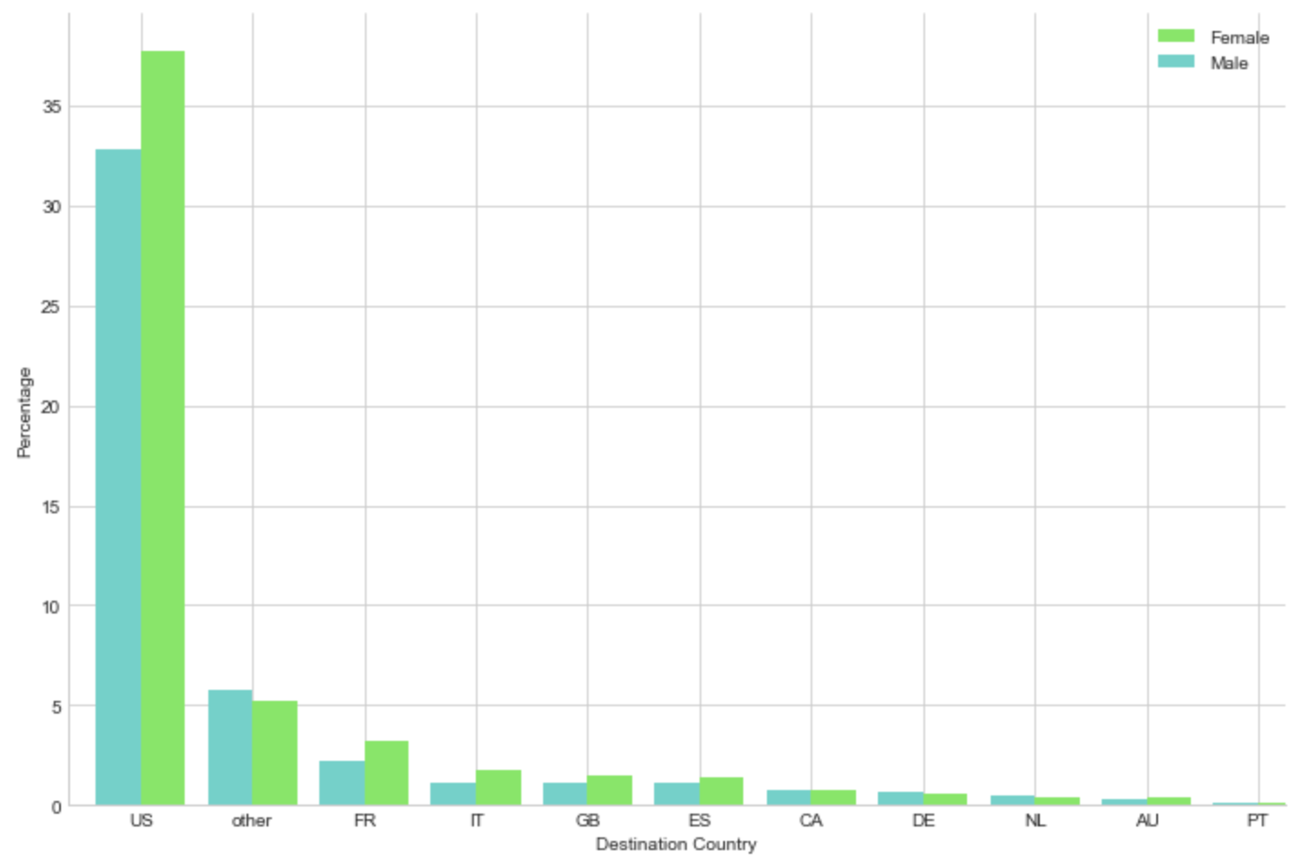
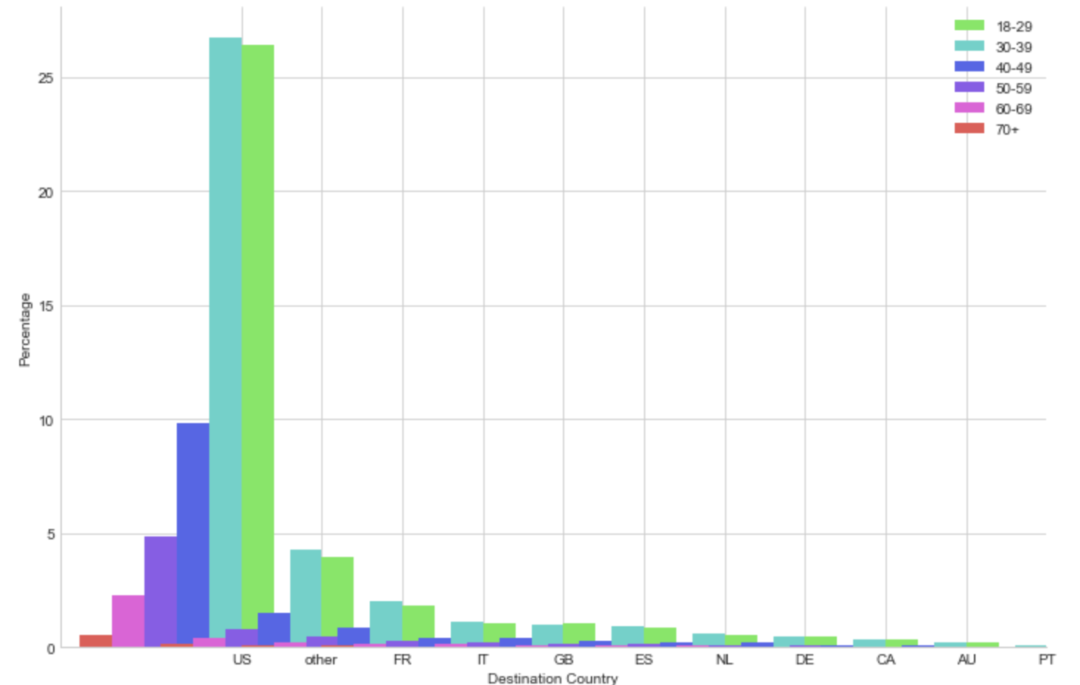
Who are the AirBnB users?
A descriptive analysis (destination)
5
6
Gender & Destination Preference
Females display slightly more interest(5% points) in the US than males
Age and Destination Preference
Age groups [18-29] and [30-39] displays more interest in the US than other age groups
Notes:
Looking at the breakdown of Airbnb users going to the US, we can see that females have a higher interest in the US compared to males and we can also see that younger people are the majority of users going to the US.
Now I’ll hand it over to Micheal to talk about our model building

Slide 11
Model Building
03

Slide 12
Data Preparation
We split the data into training and testing sets
We removed a few variables that did not hold any significance
We changed some categorical variables into dummy variables for easier processing

Slide 13
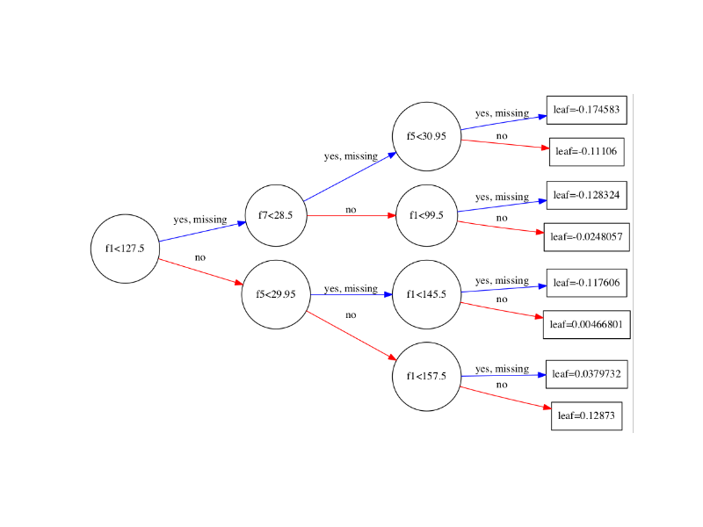
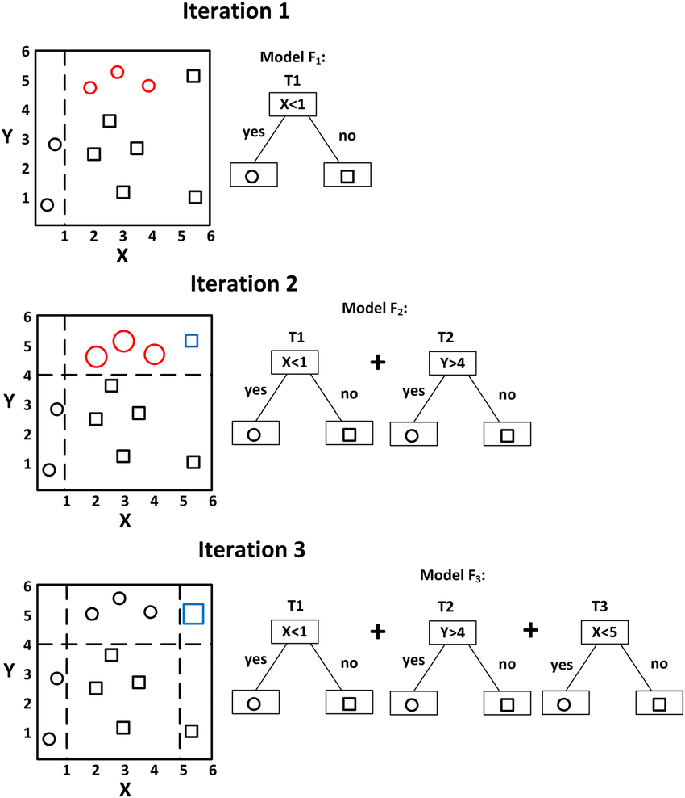

XGBoost
Extreme Gradient Boosting (XGBoost) is an iterative algorithm that incorporates decision trees into a similar logic as simple gradient boosting

Slide 14
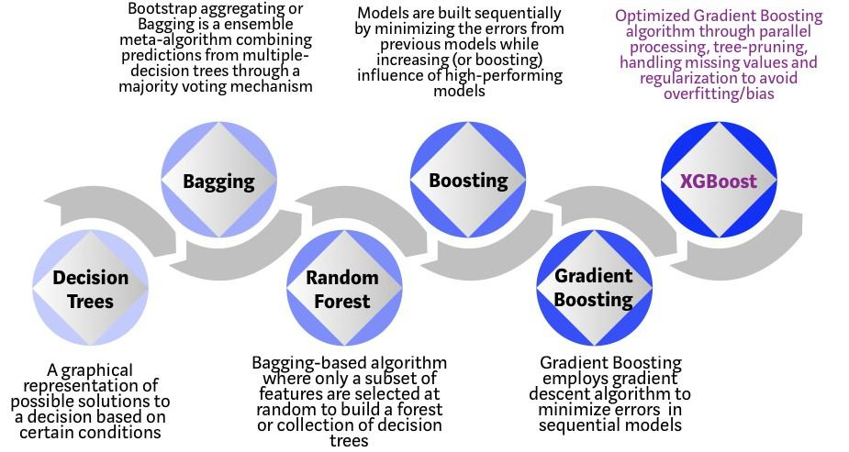
Why XGBoost?
Can handle missing data
Generally outperforms similar ensemble/iterative based algorithms
Robust to outliers in inputs by regularising data

Slide 15
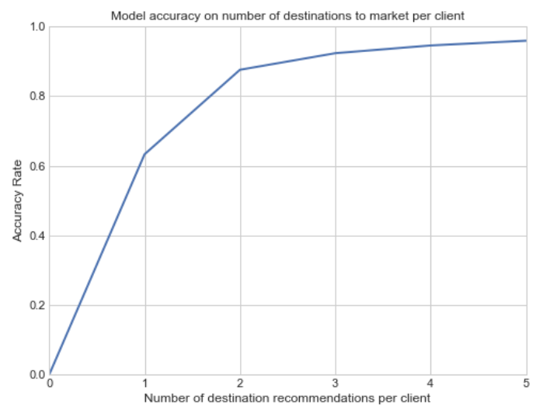
Model Evaluation
Evaluated by the accuracy score
Accuracy score increases at a diminishing rate
Can predict top 2+ destinations with over 80% accuracy
Can predict top 3+ destinations with over 90% accuracy

Slide 16
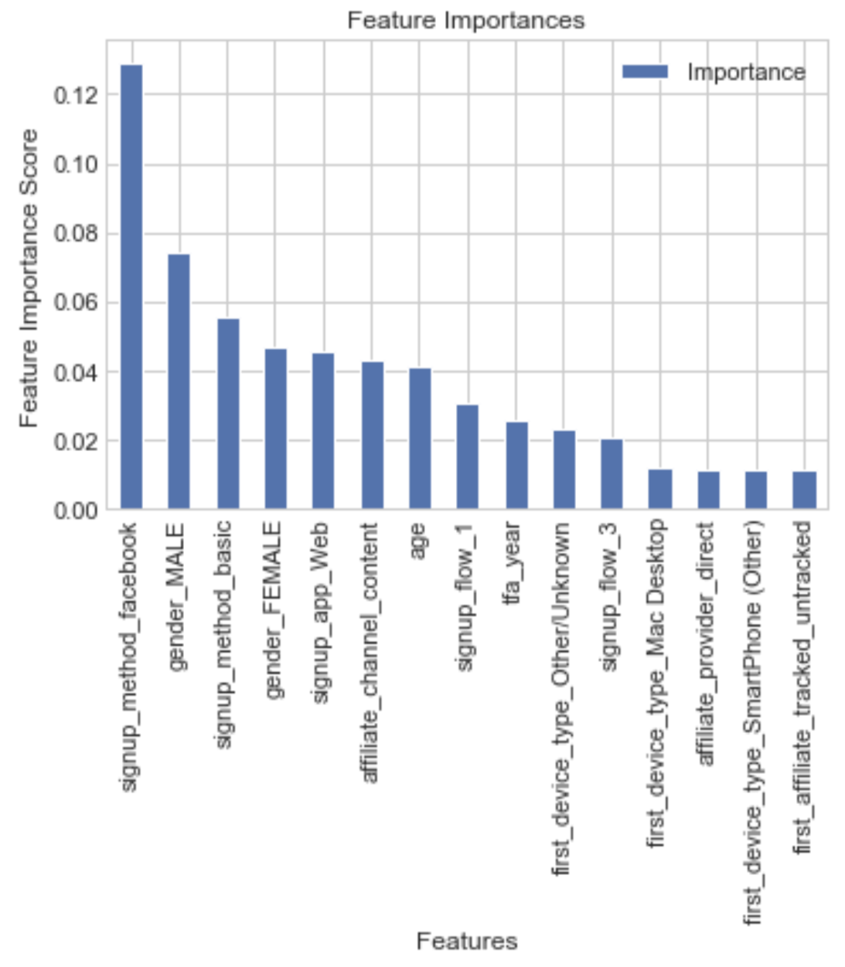
Feature Importance
Implications:
The features which have the most significance on predictive power are:
Signup method
Gender
Age
Notes:
There are 153 features in the dataset and this displayed the top 15

Slide 17
Recommendations
04

Slide 18
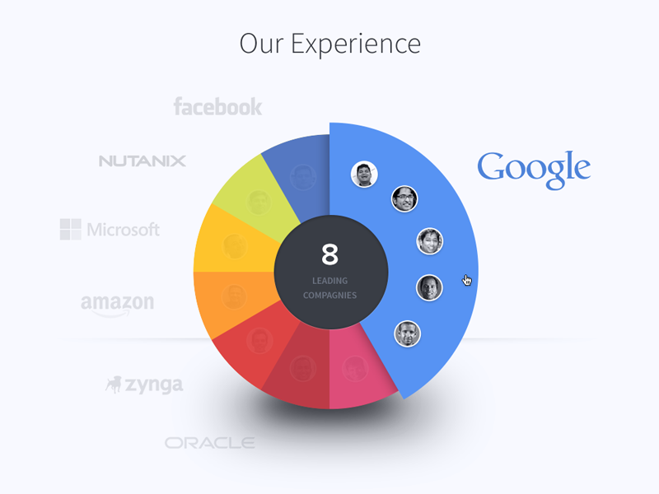

Further Exploration
What strategy to employ?
Where must we conduct further research?
We have identified some of the most important factors as:
Gender
Signup Method
Affiliate Channel
Age
Investigating a causal link between these factors and different destinations will provide insight on how to package our products
Notes:
Top 3 destinations have an accuracy rate of 92.31% which is significantly accurate, and providing more recommendations not only increases the accuracy by an insignificant amount but also would overwhelm and confuse the customer and may cause no bookings at all.

Slide 19
2. Recommend destinations when users sign up
How many destinations to recommend?
Our model was able to identify predictive factors in a user and the importance of each feature. User’s destination preference is now predicted so AirBnB can curate a personalized list of destinations to the user.
Top 3 destinations have an accuracy rate of 92.31%
Notes:
Top 3 destinations have an accuracy rate of 92.31% which is significantly accurate, and providing more recommendations not only increases the accuracy by an insignificant amount but also would overwhelm and confuse the customer and may cause no bookings at all.

Slide 20
3. Social Media Marketing
Why Social Media?
How would AirBnB carry out targeted marketing on Social Media?
Signup Method has the highest feature importance score out of all features
Airbnb can place advertisements on Social Media to increase customer attraction rates. The brand can tailor the locations featured in the ads based on the user’s Social Media profile which includes the required information of their gender, age and location.

Slide 21
Thank you!
Any questions?

